Slide 1
Chapter 2
SOFTWARE PROCESS MODELS AND AGILITY
Total Hour:5hrs
Presented by
Er.Harendra Bikram Shah
Lecturer
Department of Computer Engineering

Slide 2
OUTLINES
Software Development Lifecycle (SDLC)
Waterfall, Incremental, Prototyping, Iterative, Spiral, Rapid Application Development, Aspect Oriented SE
Agile Software Development
1. Extreme Programming
2. Scrum
3. Agile Project Management and Scaling Agile Methods
Pros and Cons of Process Models and their Applicability

Slide 3
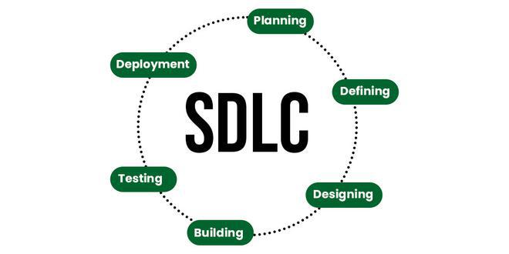
Software Development Life Cycle[SDLC]
It refers to the process of designing, creating, deploying, and maintaining software applications or systems.
It involves a systematic approach to building software that meets specific requirements and objectives.

Slide 4
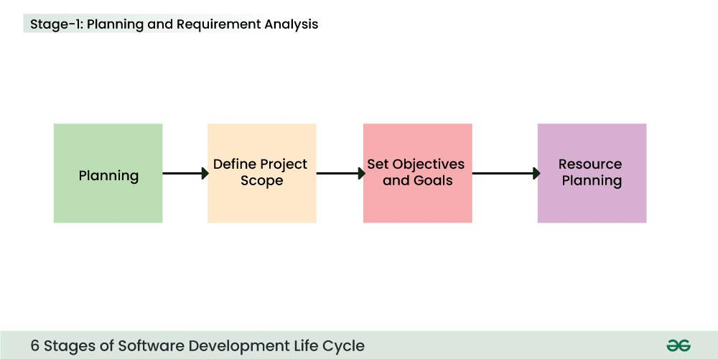

Slide 5
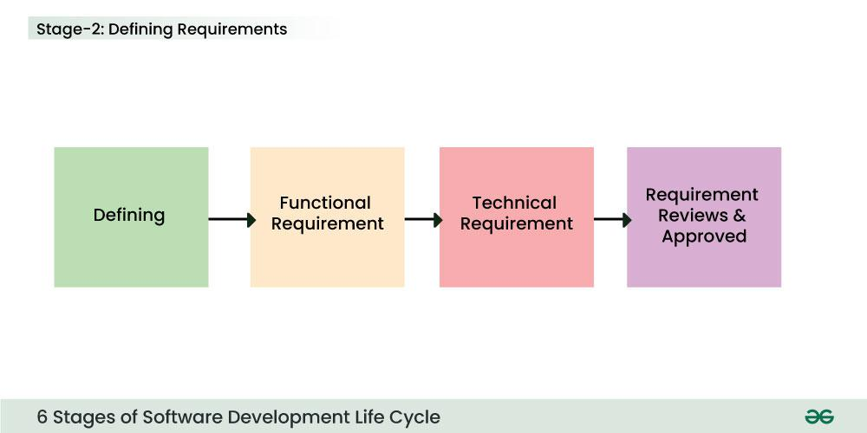

Slide 6
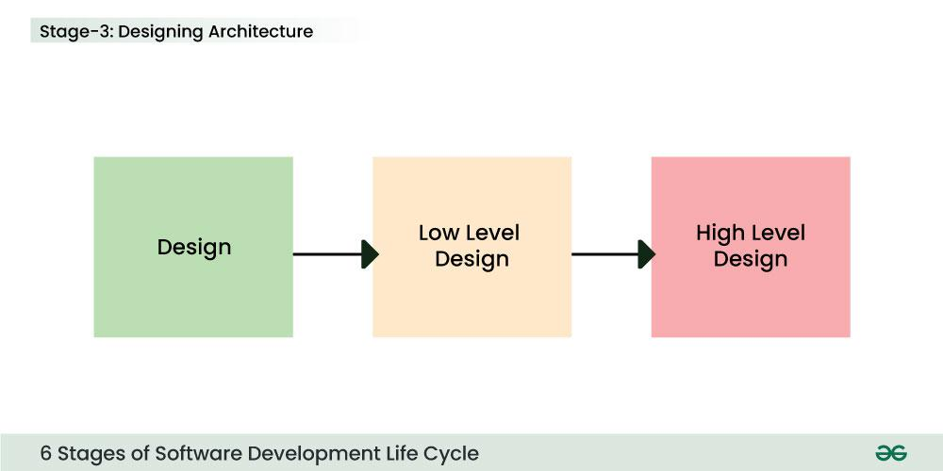

Slide 7
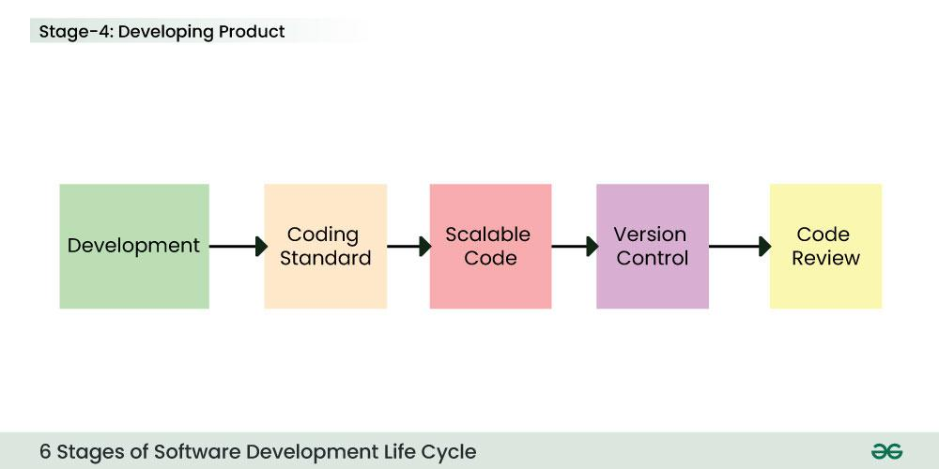

Slide 8
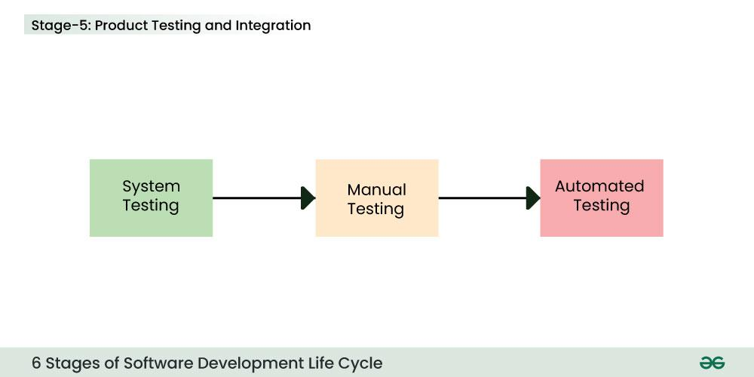

Slide 9
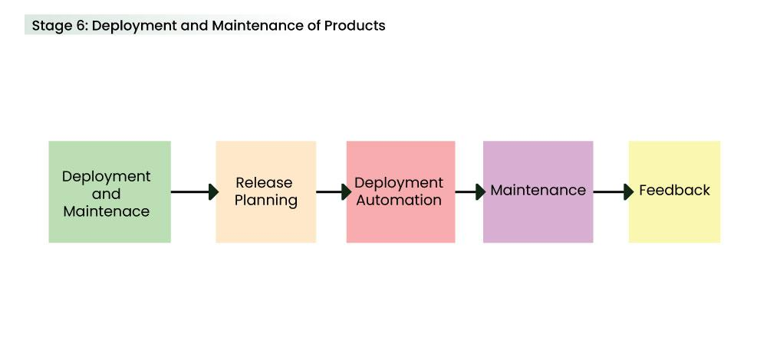

Slide 10
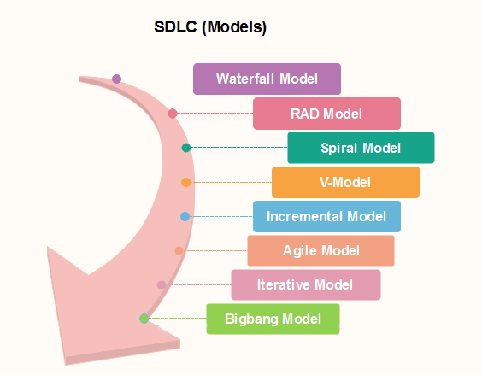
Software Development Models

Slide 11
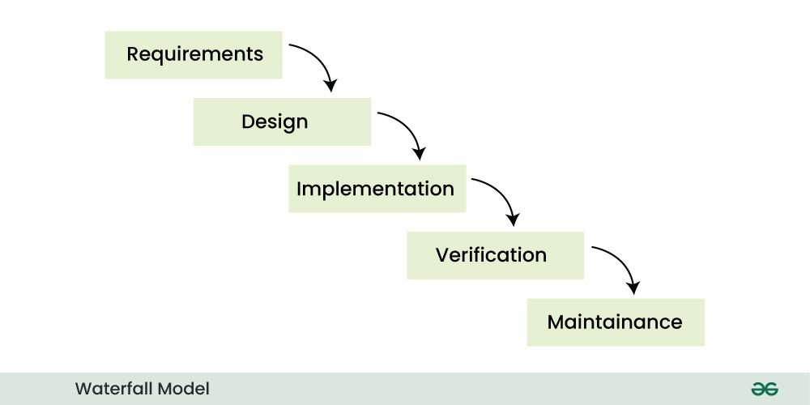
Software Development Models

Slide 12
When To Use this Model??
When the requirements are constant and not changed regularly.
A project is short
Where the tools and technology used is consistent and is not changing
When resources are well prepared and are available to use.
Advantages:
Simple and easy to understand and use.
Phases do not overlap.
Waterfall model works well for smaller projects where requirements are very well understood.
Disadvantages:
High amounts of risk and uncertainty.
Not a good model for complex projects.
Poor model for long and ongoing projects.
Not suitable for the projects where requirements are at a moderate to high risk of changing.

Slide 13
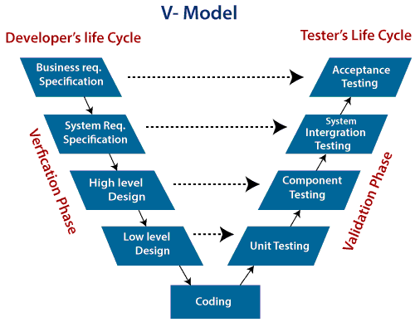
Software Development Models

Slide 14
When to use V-Model?
When the requirement is well defined and not ambiguous.
The V-shaped model should be used for small to medium-sized projects where requirements are clearly defined and fixed.
The V-shaped model should be chosen when sample technical resources are available with essential technical expertise.
Advantage :
Easy to Understand.
Testing Methods like planning, test designing happens well before coding.
This saves a lot of time
Avoids the downward flow of the defects.
Works well for small plans where requirements are easily understood.
Disadvantage :
Very rigid and least flexible.
Not a good for a complex project.
Software is developed during the implementation stage, so no early prototypes of the software are produced.
If any changes happen in the midway, then the test documents along with the required documents, has to be updated.

Slide 15
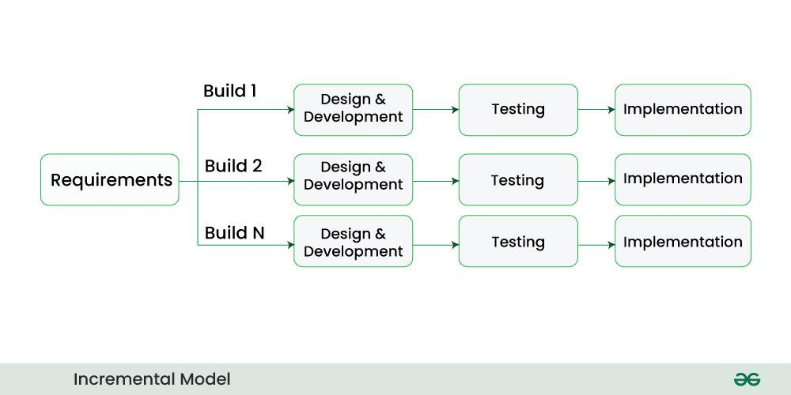
Software Development Models

Slide 16
When to use the Incremental Model?
When the requirements are superior.
A project has a lengthy development schedule.
When Software team are not very well skilled or trained.
When the customer demands a quick release of the product.
You can develop prioritized requirements first.
Advantage:
Errors are easy to be recognized.
Easier to test and debug
More flexible.
Simple to manage risk because it handled during its iteration.
The Client gets important functionality early.
Disadvantage:
Need for good planning
Total Cost is high.
Well defined module interfaces are needed.

Slide 17
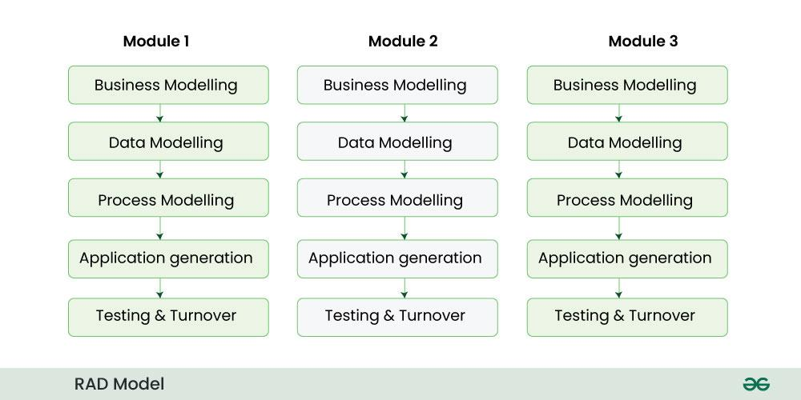
Software Development Models

Slide 18
When to use RAD Model?
When the system should need to create the project that modularizes in a short span time (2-3 months).
When the requirements are well-known.
When the technical risk is limited.
When there's a necessity to make a system, which modularized in 2-3 months of period.
It should be used only if the budget allows the use of automatic code generating tools.
Advantage of RAD Model
This model is flexible for change.
In this model, changes are adoptable.
It reduced development time.
It increases the reusability of features.
Disadvantage of RAD Model
It required highly skilled designers.
For smaller projects, we cannot use the RAD model.
On the high technical risk, it's not suitable.
Required user involvement.

Slide 19
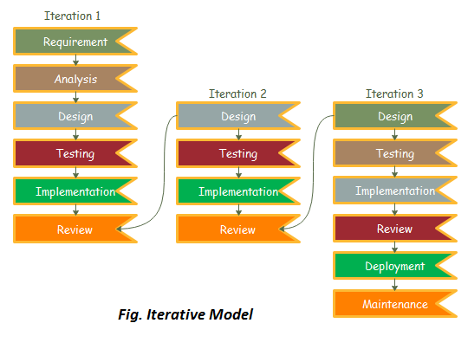
Software Development Models

Slide 20
When to use the Iterative Model?
When requirements are defined clearly and easy to understand.
When the software application is large.
When there is a requirement of changes in future.
Advantage:
Testing and debugging during smaller iteration is easy.
A Parallel development can plan.
It is easily acceptable to ever-changing needs of the project.
Risks are identified and resolved during iteration.
Limited time spent on documentation and extra time on designing.
Disadvantage:
It is not suitable for smaller projects.
More Resources may be required.
Design can be changed again and again because of imperfect requirements.
Requirement changes can cause over budget.
Project completion date not confirmed because of changing requirements.

Slide 21
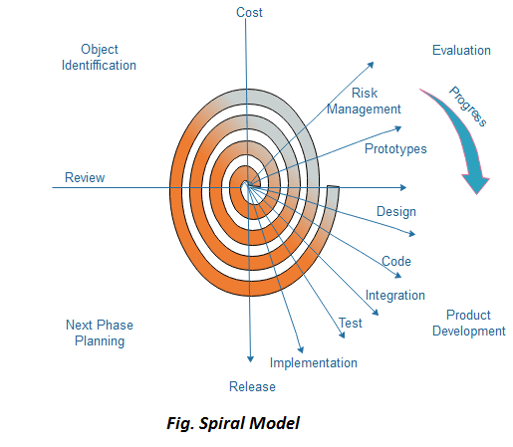
Software Development Models

Slide 22
When to use Spiral Model?
When deliverance is required to be frequent.
When the project is large
When requirements are unclear and complex
When changes may require at any time
Large and high budget projects
Advantages
High amount of risk analysis
Useful for large and mission-critical projects.
Disadvantages
Can be a costly model to use.
Risk analysis needed highly particular expertise
Doesn't work well for smaller projects.

Slide 23
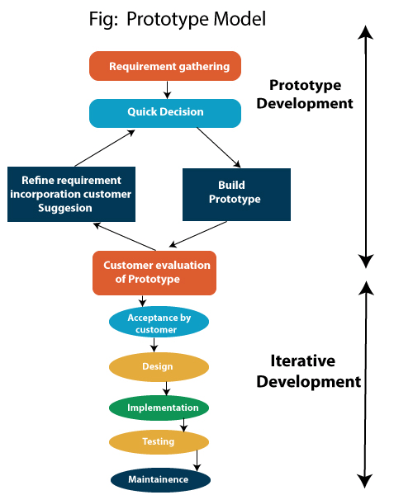
Software Development Models

Slide 24
When to Use Prototyping Model?
Changing product requirements
Understanding the feasibility of the product
The final product requires continuous user interactions
Advantage:
Reduce the risk of incorrect user requirement
Good where requirement are changing/uncommitted
Regular visible process aids management
Support early product marketing
Reduce Maintenance cost.
Errors can be detected much earlier as the system is made side by side.
Disadvantage:
Needs committed customer
Difficult to finish if customer withdraw
Difficult to know how long the project will last.
Prototyping tools are expensive.
It is a time-consuming process.

Slide 25
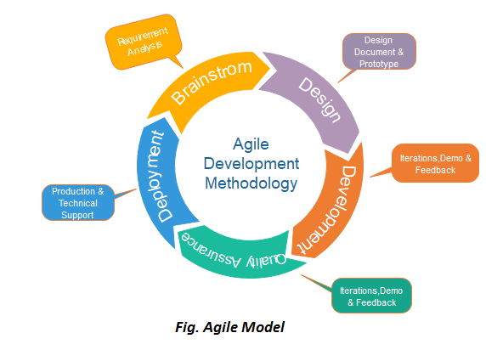
Software Development Models

Slide 26
When to use the Agile Model?
When frequent changes are required.
When a highly qualified and experienced team is available.
When a customer is ready to have a meeting with a software team all the time.
When project size is small.
Advantage:
Frequent Delivery
Face-to-Face Communication with clients.
Efficient design and fulfils the business requirement.
Anytime changes are acceptable.
It reduces total development time.
Disadvantages:
LAck of complete formal documents
Due to the lack of proper documentation, once the project completes and the developers allotted to another project, maintenance of the finished project can become a difficulty.

Slide 27
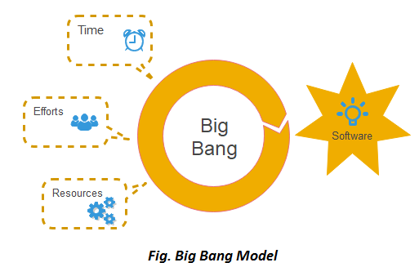
Software Development Models

Slide 28
When to use Big Bang Model?
When the project is small like an academic project or a practical project.
This method is also used when the size of the developer team is small
When requirements are not defined, and the release date is not confirmed or given by the customer.
Advantage:
There is no planning required.
Simple Model.
Few resources required.
Easy to manage.
Flexible for developers.
Disadvantage:
There are high risk and uncertainty.
Not acceptable for a large project.
If requirements are not clear that can cause very expensive.

Slide 29
Agile Software Development
Agile Software Development is an iterative and incremental approach to Software development that emphasizes the importance of delivering a working product quickly and frequently.
It involves close collaboration between the development team and the customer to ensure that the product meets their needs and expectations.
Why Agile is Used?
Creating Tangible Value:
Concentrate on Value-Added Work:
Agile as a Mindset:
Quick Response to Change:
Regular Demonstrations:
Cross-Functional Teams:

Slide 30
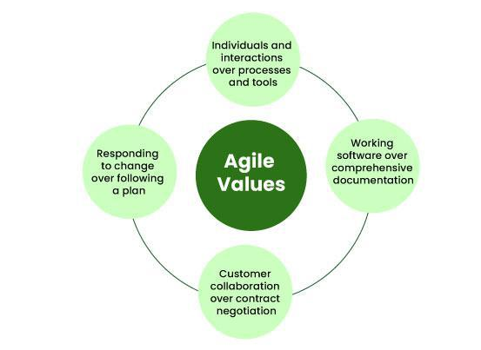
4 Core Values of Agile Software Development

Slide 31
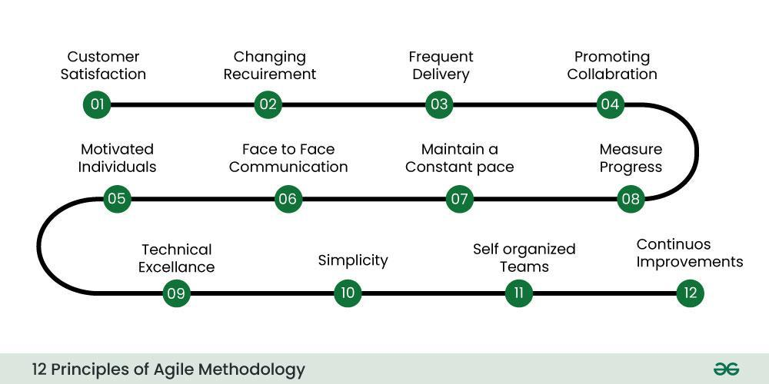
12 Principles of Agile Software Development

Slide 32
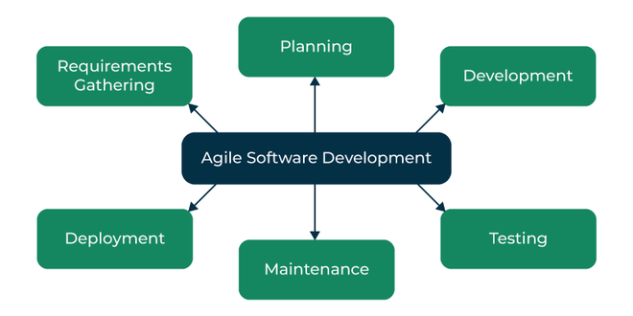
Agile Software Development Process

Slide 33
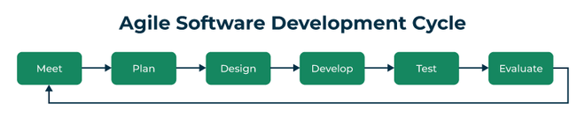
Agile Software development cycle
Agile philosophy.
concept
inception
iteration/construction
release
production
retirement

Slide 34
Advantages of Agile Software Development over traditional software development approaches
Increased customer satisfaction:
Faster time-to-market:
Reduced risk:
Improved team collaboration:
Adaptability to change:
Better quality software:
Increased transparency:
Higher productivity:
Improved project control:

Slide 35
Practices of Agile Software Development
Scrum: Scrum is a framework for agile software development that involves iterative cycles called sprints, daily stand-up meetings, and a product backlog that is prioritized by the customer.
Kanban: Kanban is a visual system that helps teams manage their work and improve their processes. It involves using a board with columns to represent different stages of the development process, and cards or sticky notes to represent work items.
Continuous Integration: Continuous Integration is the practice of frequently merging code changes into a shared repository, which helps to identify and resolve conflicts early in the development process.
Test-Driven Development: Test-Driven Development (TDD) is a development practice that involves writing automated tests before writing the code. This helps to ensure that the code meets the requirements and reduces the likelihood of defects.
Pair Programming: Pair programming involves two developers working together on the same code. This helps to improve code quality, share knowledge, and reduce the likelihood of defects.

Slide 36
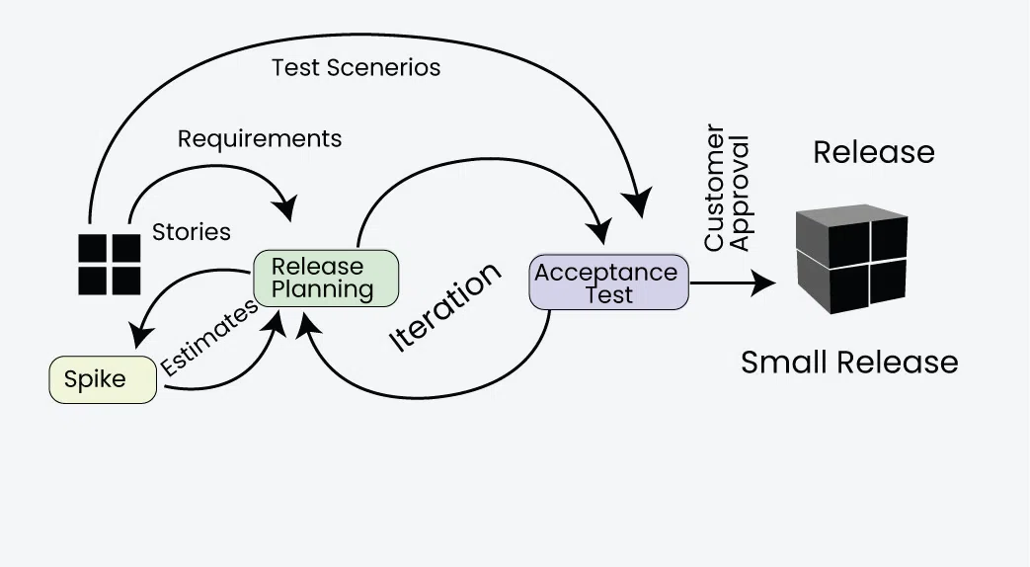
EXTREME PROGRAMMING (XP)
Focuses on delivering high-quality software through frequent and continuous feedback, collaboration, and adaptation.
XP emphasizes a close working relationship between the development team, the customer, and stakeholders, with an emphasis on rapid, iterative development and deployment.

Slide 37
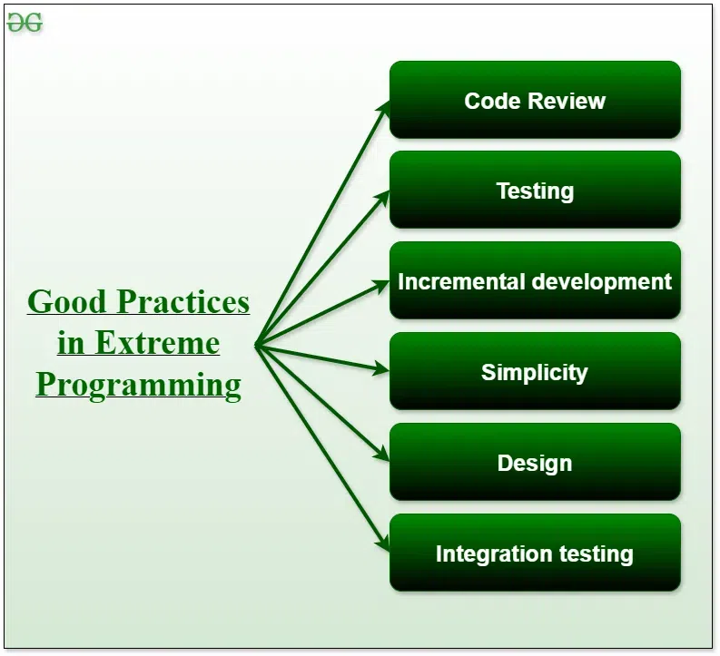
Good Practices in Extreme Programming

Slide 38
Principles of Extreme Programming
Coding: drawing diagrams (modeling) that will be transformed into code, scripting a web-based system
Testing: The XP model gives high importance to testing and considers it to be the primary factor
Listening: The developers need to carefully listen to the customers if they have to develop good quality software.
Designing: A good design results elimination of complex dependencies within a system
Feedback: gain feedback to understand the exact customer needs.
Simplicity: The main principle of the XP model is to develop a simple system that will work efficiently in the present time
Pair Programming: XP encourages pair programming where two developers work together at the same workstation.
Continuous Integration: In XP, developers integrate their code into a shared repository several times a day.
Refactoring: XP encourages the process of restructuring existing code to make it more efficient and maintainable.
Collective Code Ownership: the entire team is responsible for the codebase.
Planning Game: the customer and the development team collaborate to prioritize and plan development tasks.
On-site Customer: XP requires an on-site customer who works closely with the development team throughout the project.

Slide 39
Applications of Extreme Programming (XP)
Some of the projects that are suitable to develop using the XP model are given below:
Small projects:
Projects involving new technology or Research projects:
Web development projects:
Collaborative projects:
Projects with tight deadlines:
Projects with rapidly changing requirements:
Projects where quality is a high priority:

Slide 40
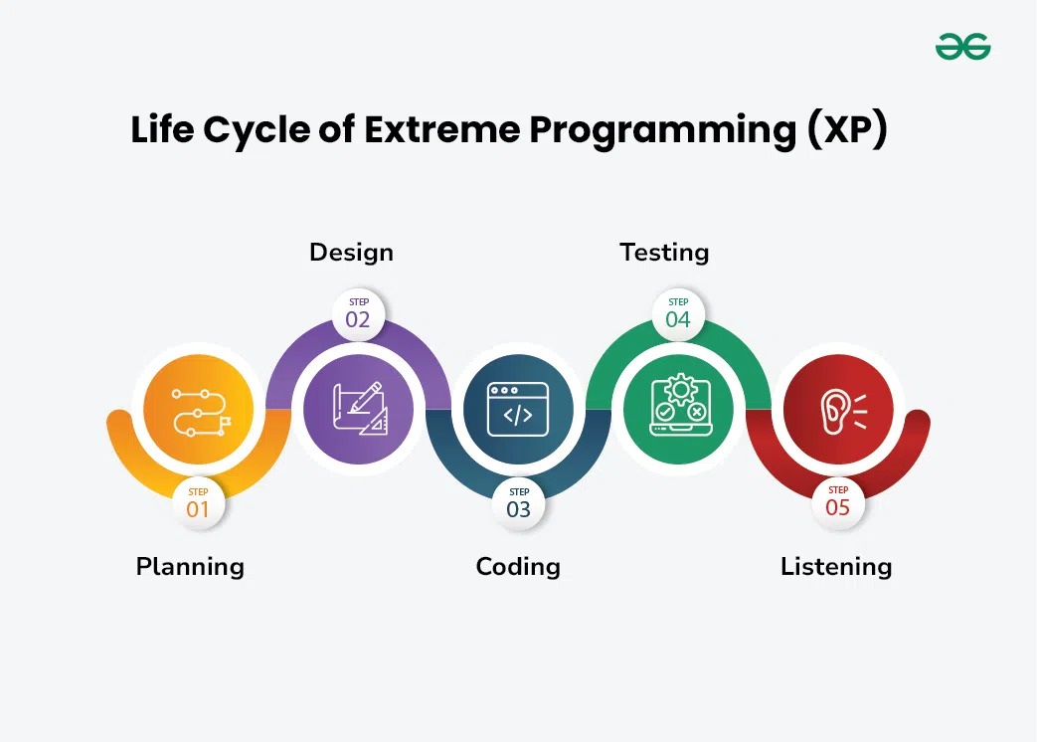

Slide 41
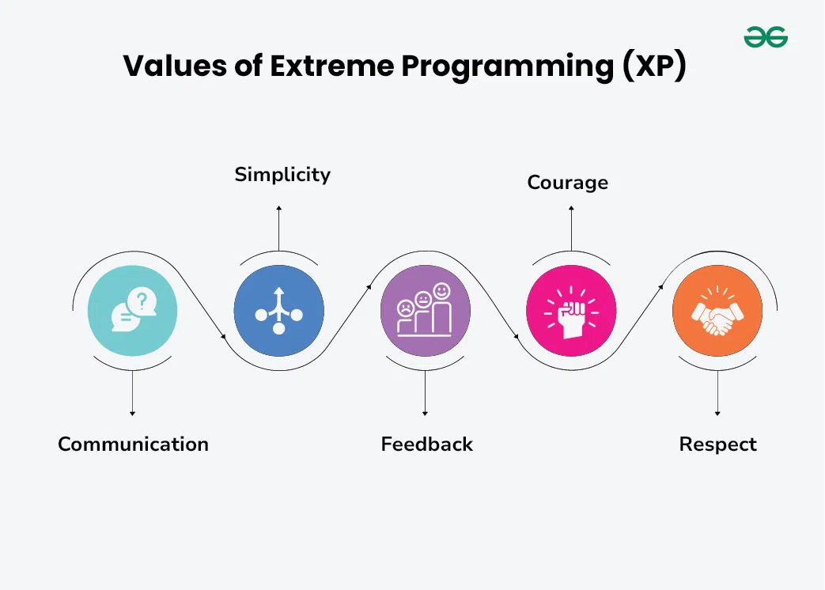

Slide 42
Advantages of Extreme Programming (XP)
Slipped schedules:
No Misunderstanding the business and/or domain
Cancelled projects:
Staff turnover:
Costs incurred in changes:
Business changes:
Production and post-delivery defects:

Slide 43
Scrum
Scrum is a management framework that teams use to self-organize tasks and work towards a common goal.
It is a framework within which people can address complex adaptive problems while the productivity and creativity of delivering products are at the highest possible value.
Silent features of Scrum
Scrum is a light-weighted framework
Scrum emphasizes self-organization
Scrum is simple to understand
Scrum framework helps the team to work together

Slide 44
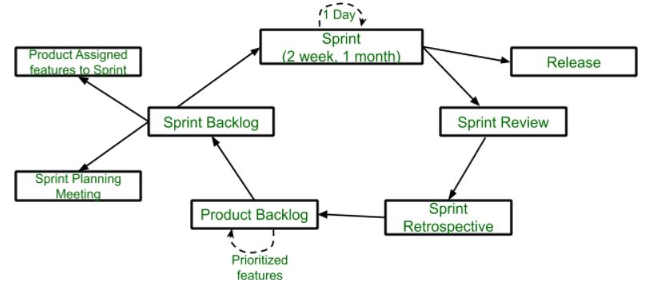
Lifecycle of Scrum

Slide 45
Lifecycle of Scrum
Advantage of Scrum framework
Scrum framework is fast moving and money efficient.
Scrum framework works by dividing the large product into small sub-products. It’s like a divide and conquer strategy
In Scrum customer satisfaction is very important.
Scrum is adaptive in nature because it have short sprint.
As Scrum framework rely on constant feedback therefore the quality of product increases in less amount of time
Disadvantage of Scrum framework
Scrum framework do not allow changes into their sprint.
Scrum framework is not fully described model. If you want to adopt it you need to fill in the framework with your own details like XP, DSDM, Kanban.
It can be difficult for the Scrum to plan, structure and organize a project that lacks a clear definition.
The daily Scrum meetings and frequent reviews require substantial resources.

Slide 46
Agile Project Management and Scaling Agile Methods
  Agile Project Management:
iterative and flexible approach to managing projects, initially popularized in software development but now used across various industries.
Agile emphasizes delivering value quickly, adapting to changes, and continuously improving through collaboration among cross-functional teams.
Core Principles of Agile Project Management
The Agile approach is built on principles outlined in the Agile Manifesto, which emphasizes:
Individuals and interactions over processes and tools.
Working software (or product) over comprehensive documentation.
Customer collaboration over contract negotiation.
Responding to change over following a fixed plan.
Benefits of Agile Project Management:
Faster time to market:
Improved customer satisfaction:
Increased flexibility:
Higher quality:
Enhanced team morale:

Slide 47
Agile Project Management and Scaling Agile Methods
Challenges of Agile:
Cultural shift: Adopting Agile requires a change in mindset and organizational culture.
Skill development: Teams need training and coaching to effectively implement Agile practices.
Measuring success: Traditional metrics may not be suitable for Agile projects.
Managing dependencies: In large-scale projects, coordinating dependencies can be complex.
  Scaling Agile Methods:
Scaling Agile becomes crucial when applying Agile practices across large organizations or projects involving multiple teams.
Traditional Agile frameworks work best with small teams, but large enterprises need coordination and alignment. Some popular scaling frameworks include:
SAFe (Scaled Agile Framework): SAFe provides a structured approach to scaling Agile across large organizations
LeSS (Large Scale Scrum): LeSS scales Scrum for multiple teams by using one Product Backlog across multiple teams
Spotify Model: Developed by Spotify, this model organizes people into "squads" (similar to Scrum teams) and groups
Disciplined Agile Delivery (DAD): DAD provides a decision-making framework that helps teams choose between various Agile and Lean techniques based on the project needs.

Slide 48
Pros and Cons of Process Models and their Applicability
Pros and Cons of Process Models
Pros:
Structure and Organization:
Risk Management:
Quality Assurance:
Team Collaboration:
Customer Satisfaction:
Cons:
Rigidity:
Overemphasis on Documentation:
Limited Adaptability:
Complexity:

Slide 49
Applicability of Process Models
Applicability of Process Models:
The choice of a process model depends on various factors, including:
Project Size and Complexity:
Requirement Certainty:
Customer Involvement:
Risk Tolerance:
Team Experience and Maturity:

Slide 50
End of The End

Slide 51
THANK YOU

